Slide 1

MSE 311: Thermodynamics of Materials
Lecture 15: Phase diagram-I
Weishu Liu
Department of Materials Science and Engineering
Southern University of Science and Technology (SUSTech)
Email: liuws@sustech.edu.cn
Office: North Tower1#, Rm310

Slide 2
39. A short history of phase diagram
Chapter 10
Gibbs Free energy Composition and Phase diagrams of Binary System
Ref. Introduction to the thermodynamics of Materials, 6th edition, D. R. Gaskell, and D. E. Laughlin

Slide 3
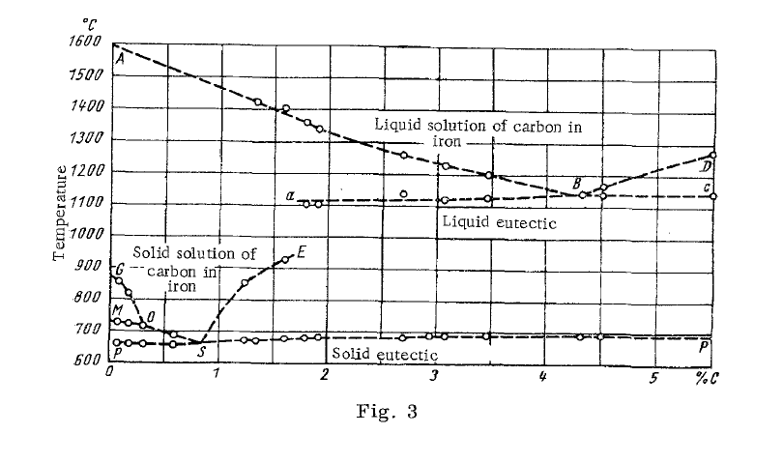
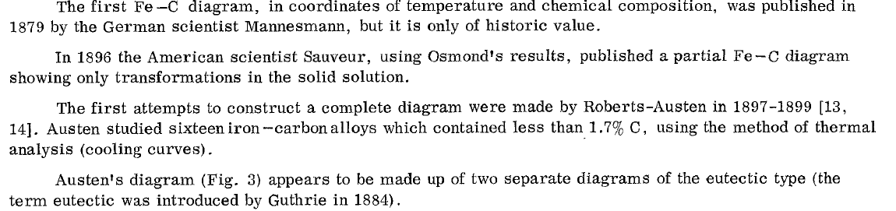
Fe-C phase diagram

Slide 4
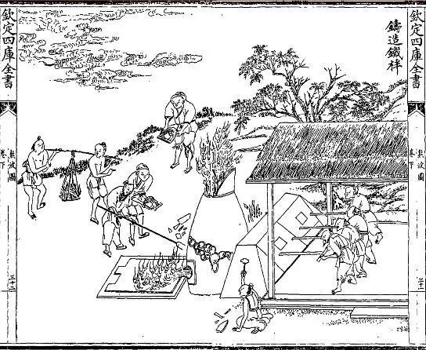
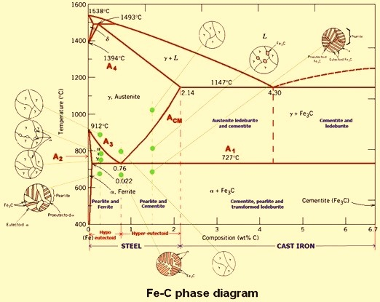
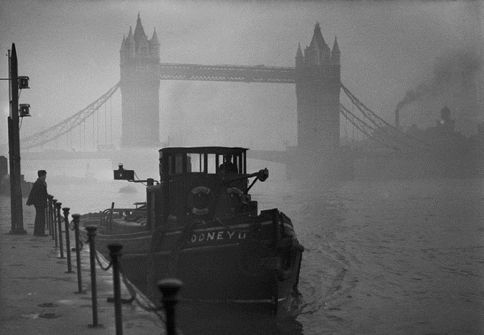
Fe-C phase diagram
19th century， London
Fe-C Phase diagram

Slide 5

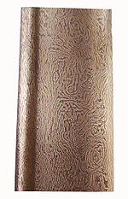
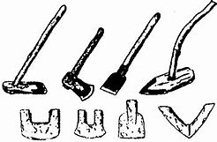
The history of steel
The earliest known production of steel is seen in pieces of ironware excavated from an archaeological site in Anatolia (Kaman-Kalehöyük) and are nearly 4,000 years old, dating from 1800 BC
The falcata is a type of sword typical of pre-Roman Iberia.
The Chinese of the Warring States period (403–221 BC) had quench-hardened steel
Woots Steel or Damascus steel
战国时期

Slide 6
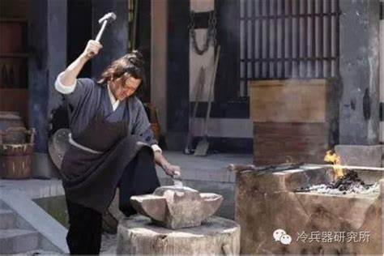
The history of steel
生铁，熟铁，钢
《列子·汤问篇》鍊钢赤刃，用之切玉，如切泥焉

Slide 7
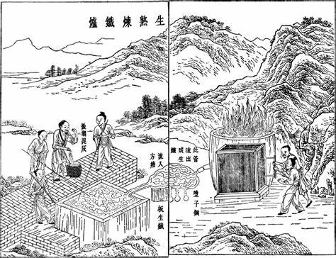
The history of steel

Slide 8

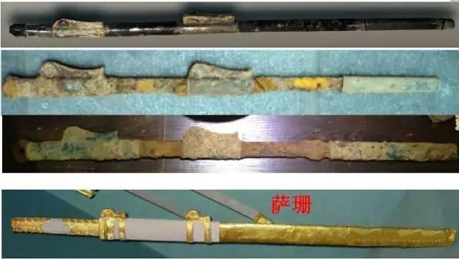
The history of steel
metallurgist
綦毋怀文
南北朝时期：420—589
南北朝， 将液态生铁浇在熟铁上，经过几度熔炼，使熟铁铁渗碳成为钢
宋代又把生铁片嵌在盘绕的熟铁条中间，用泥巴把炼钢炉密封起来，进行烧炼，效果更好
明代又有改进，把生铁片盖在捆紧的若干熟铁薄片上，使生铁液可以更好均匀地渗入熟铁之中
明中期以后，灌钢法更进一步发展为苏钢法以熟铁为料铁，置于炉中，而将生铁板放在炉口，当炉温升高到1300℃左右，生铁板开始熔化时，既用火钳夹住生铁板左右移动，并不断翻动料铁，使料铁均匀地淋到生铁液

Slide 9
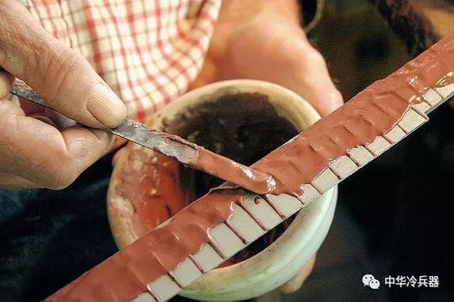
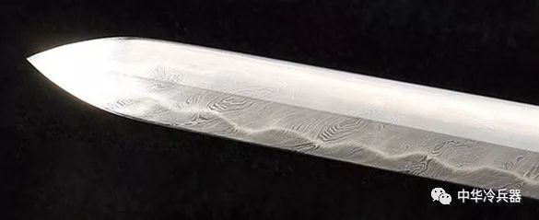
The history of steel
“烧刃”一般被称为“覆土烧刃” 传自初唐。日本从古代沿用至今用来锻造刀剑过程中极为关键的一道锻造工艺。大致来说就是用土包住刀胎，露出刀刃部分，之后进行淬火工艺。这样可以让刃与刀身的硬度不同，刃的硬度要比其刀身高很多，一把刀成型以后就具备了很好的柔韧性的同时还能保持较高的刀刃硬度，这样一来即可以增加使用寿命，又具有出色的使用性能

Slide 10
40. Over view of phase diagram
Chapter 10
Gibbs Free energy Composition and Phase diagrams of Binary System
Ref. Introduction to the thermodynamics of Materials, 6th edition, D. R. Gaskell, and D. E. Laughlin

Slide 11
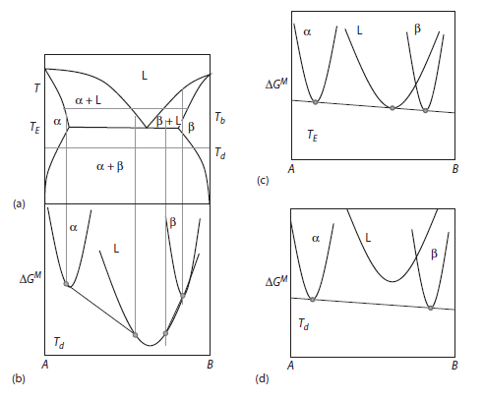



Eutectic and Eutectoid Phase Diagrams
Eutectic phase diagram
（共晶相图）
Eutectic point
Eutectic reaction
L→α+β
Hypoeutectic reaction
Hypereutectic reaction
Eutectoid Phase Diagrams （共析相图）
If the high-temperature phase in these diagrams is replaced by a solid phase,
the diagram is called a eutectoid (eutectic-like) phase diagram

Slide 12
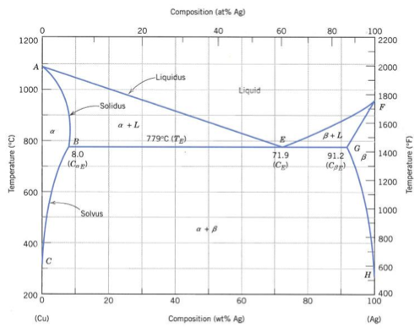
A Eutectic point in the Cu-Ag phase diagram

Slide 13
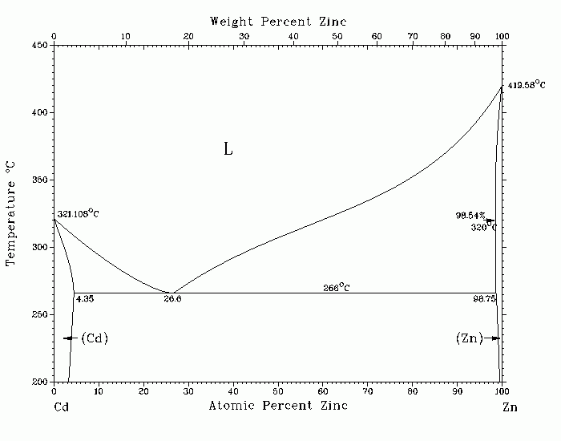
A Eutectic point in the Cd-Zn phase diagram

Slide 14
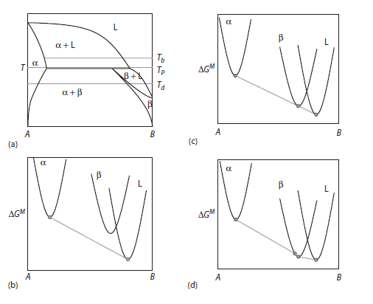



Peritectic and Peritectoid Phase Diagrams
Peritectic phase diagram (包晶相图)
Peritectic reaction
hypo-peritectic reaction
hyper-peritectic reaction
Peritectoid phase diagram (包析相图)
If the liquid phase is replaced by a third solid phase, α, the diagram will look
similar but without the liquid phase. Such a diagram is called a peritectoid diagram

Slide 15
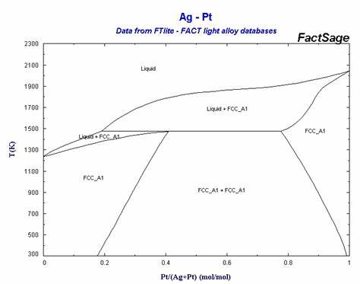
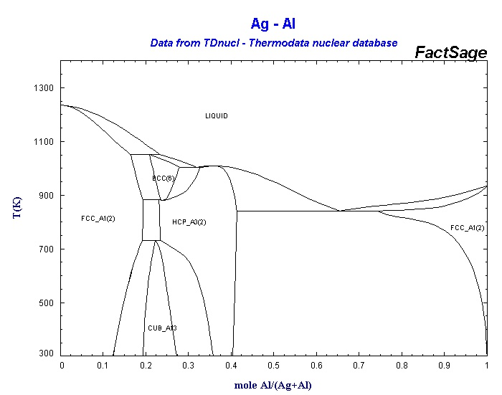
Peritectic and Peritectoid Phase Diagrams
Peritectic reaction
Peritectic reaction
α+β
α
β
γ
α+γ
β+γ

Slide 16
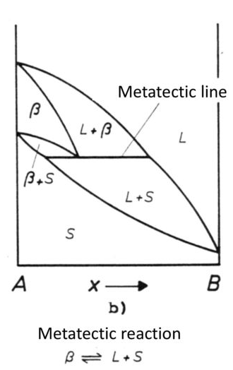
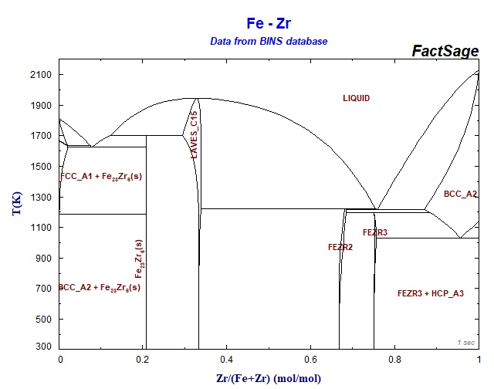
Metatectic phase diagrams
变晶相图
α
L+α
α+β
L+β
β

Slide 17
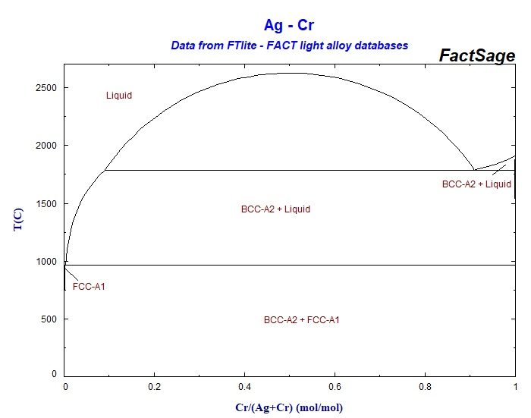
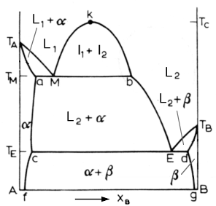
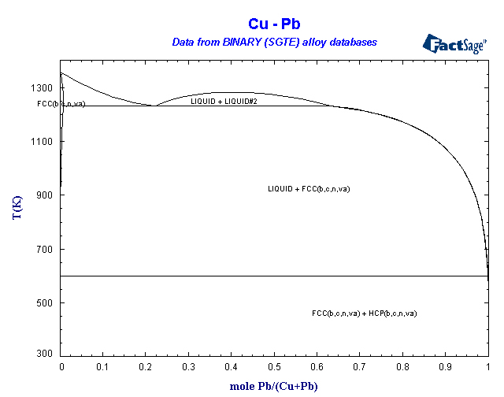
Monotectic phase diagrams
偏晶相图
L₁ → L₂ + α

Slide 18
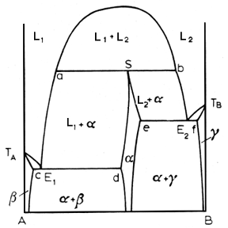
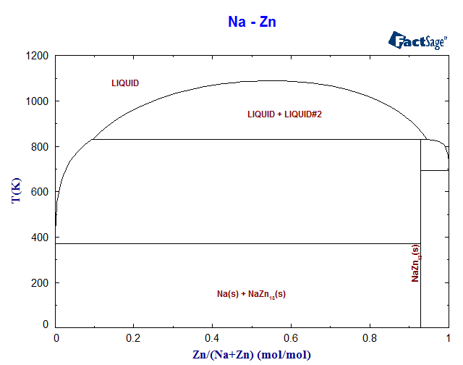
Syntectic phase diagrams
综晶相图
L₁ +L₂ → α

Slide 19
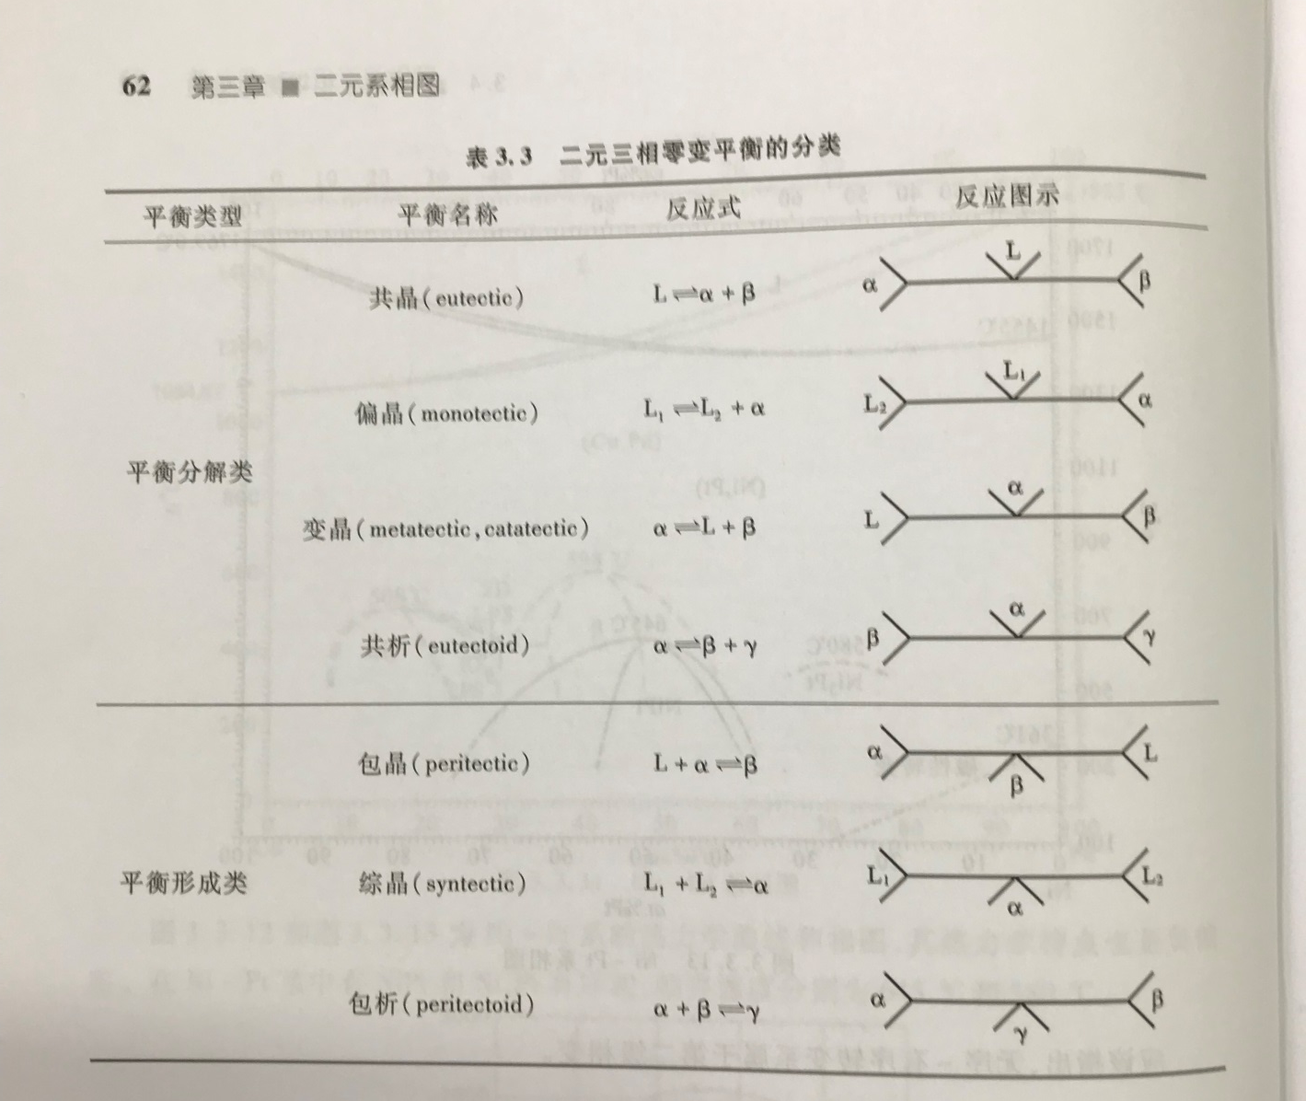
Reaction diagram

Slide 20
Whether is it exist the following
three phase equilibrium from high T to low T?
α+β→L
L₁+ α →L₂
α →L₁+ L₂

Slide 21
Phase diagram of binary system
Complete liquid and solid solutions (idea solution)
Partial solid solution
Complete liquid miscibility and solid immiscibility
41. Phase diagram -I
Chapter 10
Gibbs Free energy Composition and Phase diagrams of Binary System
Ref. Introduction to the thermodynamics of Materials, 6th edition, D. R. Gaskell, and D. E. Laughlin

Slide 22
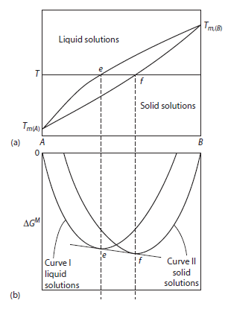
Standard state of component
Curve I: both A and B are liquid
Curve II: both A and B are solid
At temperature T, A is liquid while B is solid
Standard state of a component is simply a reference state to which the component in any other state is compared
We need a new ΔG^{M} curve by using new standard state

Slide 23
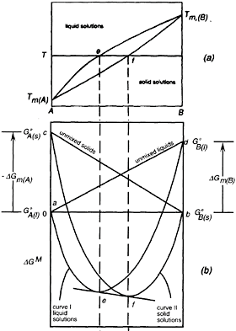
Complete liquid and solid solutions
liquid
solutions
Standard state of a component is simply a reference state to which the component in any other state is compared
It follows that any state can be chosen as the standard state, and the choice is normally made purely on the basis of convenience
solid
solutions
unmixed solids
unmixed liquid
Consider the binary system A–B at a temperature T which is below T_{m(A)} and above T_{m(B)}
This system forms Raoultian ideal liquid solutions and Raoultian ideal solid solutions
curve I : liquid solutions;
curve II: solid solutions
At the temperature T, the stable states of pure A and B are located at ΔG^{M}=0,
with pure liquid A located at X =1 (the point a)
and pure solid B located at X =1 (the point b)

Slide 24
Complete liquid and solid solutions
liquid
solutions
The point c represents the molar Gibbs free energy of solid A relative to that of liquid A at temp. T
solid
solutions
T> T_{m(A)}
That is
unmixed solids
unmixed liquid
If choose the pure liquid A and pure solid B as standard state
For point d
T< T_{m(B)}
If C_{p, A(s)}= C_{p, A(l)}

Slide 25
Complete liquid and solid solutions
liquid
solutions
The point d represents the molar Gibbs free energy of liquid B relative to that of solid B at temp. T
solid
solutions
T< T_{m(B)}
That is
unmixed solids
unmixed liquid
If choose the pure liquid A and pure solid B as standard state
If C_{p, B(s)}= C_{p, B(l)}

Slide 26
Complete liquid and solid solutions
liquid
solutions
choose the pure liquid A and pure solid B as standard state
Equation for the line ad
solid
solutions
Equation for the line cb
unmixed solids
unmixed liquid

Slide 27
Liquid and solid standard states
At any composition the formation of a homogeneous liquid solution from pure liquid A and pure solid B can be considered as being a two-step process involving
liquid
solutions
solid
solutions
1. The melting of X_{B} moles of B, which involves the change in Gibbs free energy
unmixed solids
unmixed liquid
2. The mixing of X_{B} moles liquid B and X_{A} moles liquid A to form an idea liquid solution
The formation of idea liquid solution
The formation of idea solid solution

Slide 28
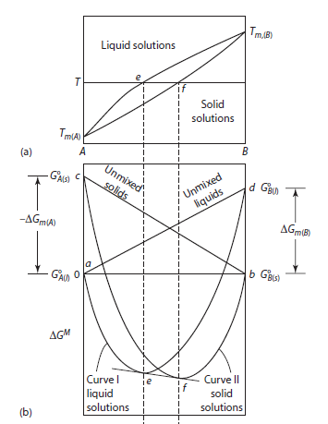
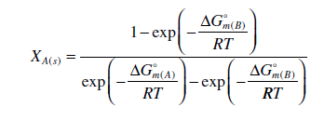

Complete liquid and solid solutions
At the composition e , the tangent to the free energy of mixing curve for the liquid solution is also the tangent to the free energy of mixing curve of the solid solution at the composition f
at the temperature T , the liquid of composition e is in equilibrium with the solid of composition f ;
the phase diagram for a system which forms ideal solid and liquid solutions is determined only by the melting temperatures and the molar heats of melting of the components

Slide 29
Derivation of complete liquid and solid solutions
For the equilibrium between the solid and liquid phase,
Lecture 13, page 12
Gibbs energy of liquid solution

Slide 30
Derivation of complete liquid and solid solutions
Gibbs energy of solid solution

Slide 31
Derivation of complete liquid and solid solutions
Similar derivation for element B, T_{m,B}>T

Slide 32
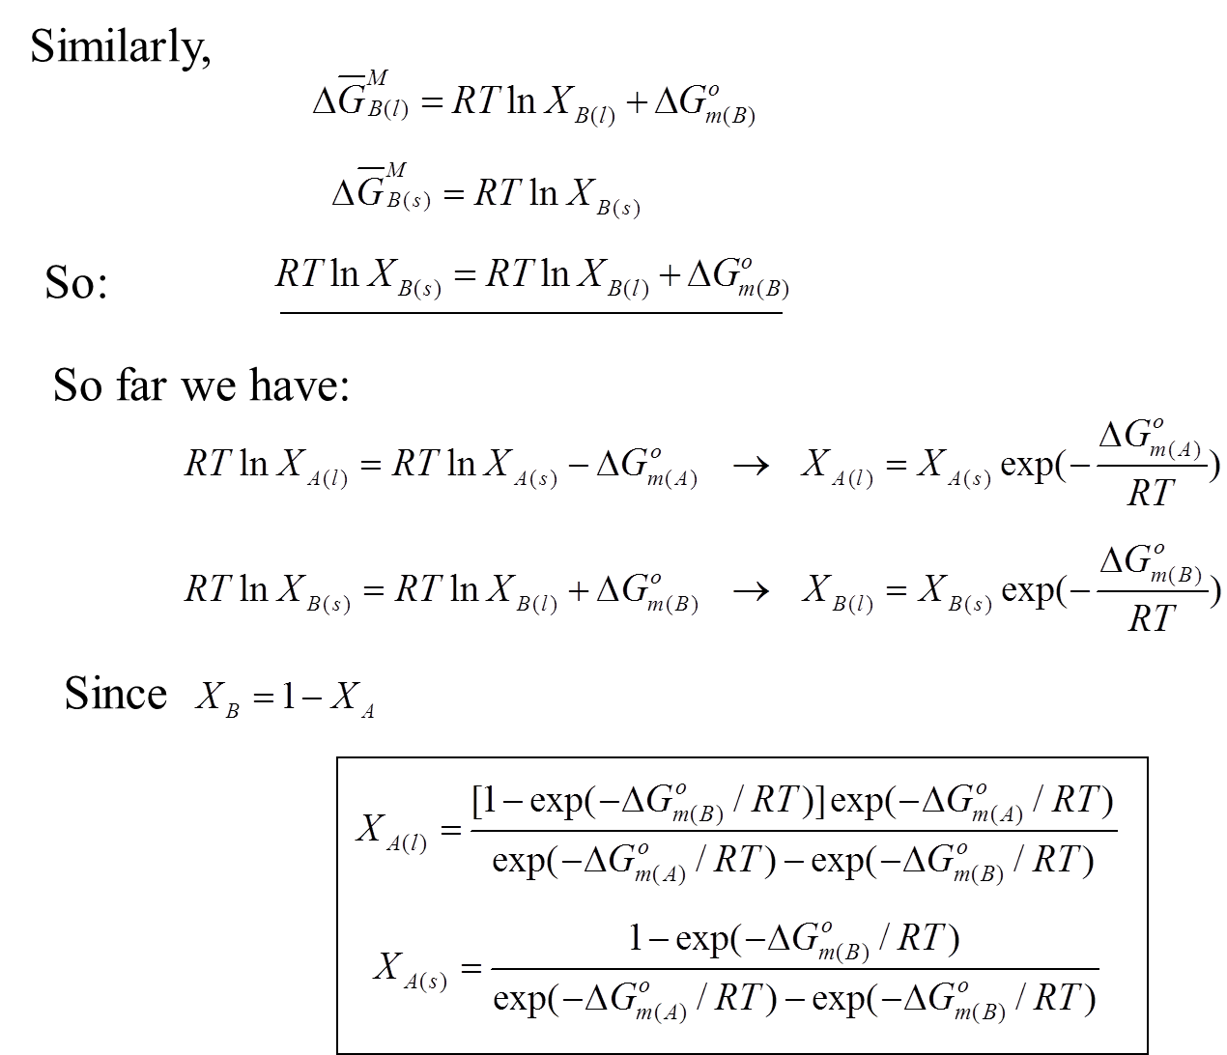
the phase diagram for a system which forms ideal solid and liquid solutions is determined only by the melting temperatures and the molar heats of melting of the components

Slide 33
Idea solution VS. non-idea solution
Idea solution case:
The formation of idea liquid solution
The formation of idea solid solution
Non-idea solution case:
The formation of non-idea liquid solution
The formation of non-idea solid solution

Slide 34
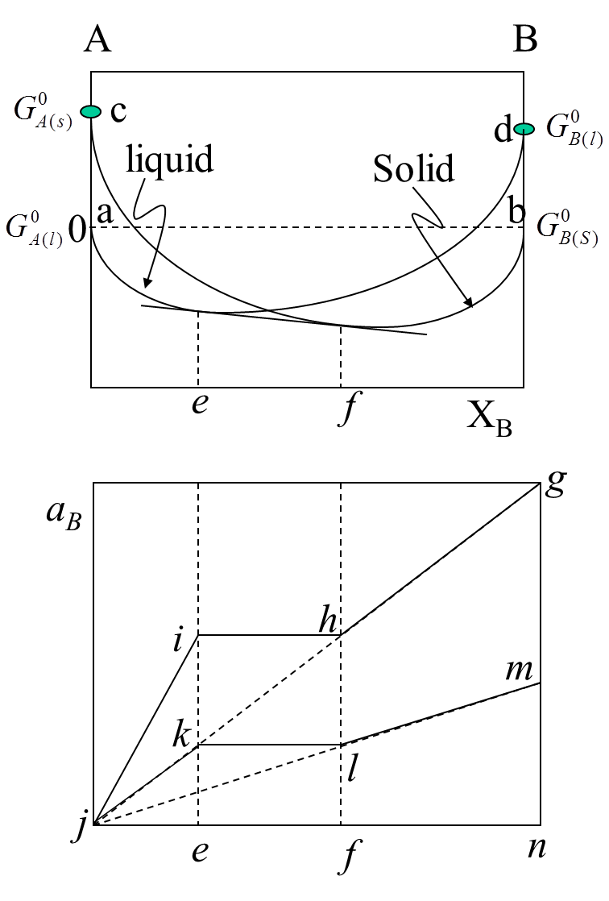
Activity-composition relationship
Pure solid B is chosen as the standard state
ghij represent the a_{B} in the solutions respect to solid B, gn=1
The line is obtained from the variation of the tangential intercepts from the curve aefb
Raoult’s law is given by the jg.
Points i and h represents the activity of B in the coexisting liquid solution e and solid solution f
Point m: represent the activity of pure liquid B measured by the solid standard state activity scale of B.
α_{B(l)}: α_{B} respected to liquid B
α_{B(s)}: α_{B} respected to solid B

Slide 35
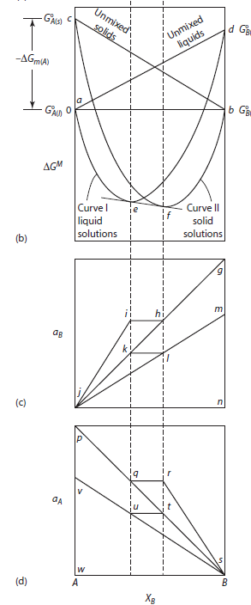
Activity-composition relationship
The general relationship between the activity and partial Gibbs energy
α_{B(l)}: α_{B} respected to liquid B
α_{B(s)}: α_{B} respected to solid B
Similar,
The formation of idea liquid solution

Slide 36
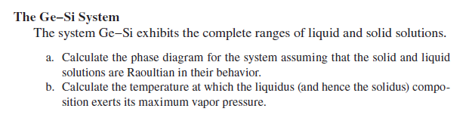
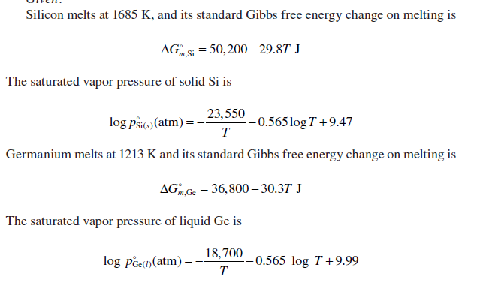
Calculate the phase diagram of Ge-Si
Given

Slide 37
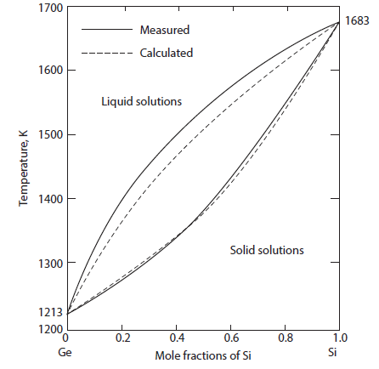
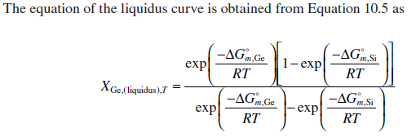
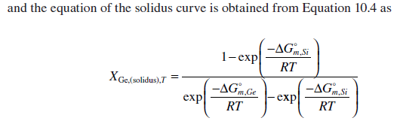
Calculate the phase diagram of Ge-Si
Calculate the phase diagram for the system assuming that the solid and liquid solutions are Raoultian in their behavior?

Slide 38

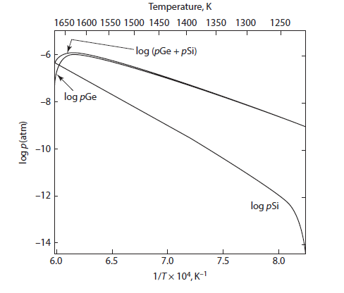



Calculate the phase diagram of Ge-Si
Calculate the temperature at which the liquidus (and hence the solidus) composition exerts its maximum vapor pressure ?

